Slide 1
Lecture No. 03
Fundamentals OF Computer Programming

Slide 2
What Computers can Understand?
Computer can only understand Machine language …and what is machine language … it is a language understandable by Machines only which is in Numbers.

Slide 3
Types of Programming Languages
Low Level Languages
High Level Languages

Slide 4
Low level Languages
Machine Language
The lowest-level programming language, machine languages can be read by computers, but are almost impossible for humans to use because they consist entirely of numbers. Machine Languages are Machine Dependent.
Example: (Overtime Pay to base pay and stores in Gross pay)
+12334444
+14005555
+343434343

Slide 5
Low Level Languages .. Contd...
Assembly Languages
Assembly languages have the same structure and set of commands as machine languages, but they enable a programmer to use names instead of numbers when writing code. Translators called Assemblers are used to covert Assembly Language program into Machine Language.
Example
Load basepay
Add overpay
Store grosspay

Slide 6
High Level Languages
These are the languages understandable by humans easily. A person can write a program with the help of these languages very easily.
Translator Programs called compilers convert High level language code into Machine language.
A single statement usually accomplishes a set of tasks.
Example
Grosspay=basepay+overtimepay

Slide 7
Language Translators
Human programmers write programs in a language that is easy to understand for them. They use language translators to convert that program into machine language. It converts the human understandable code into object code which is machine understandable code.
Compilers
Interpreters
Assemblers

Slide 8
What is a Program Made of?
Common elements in programming languages:
  Key Words
  Programmer-Defined Identifiers
  Operators
  Punctuation
  Syntax

Slide 9
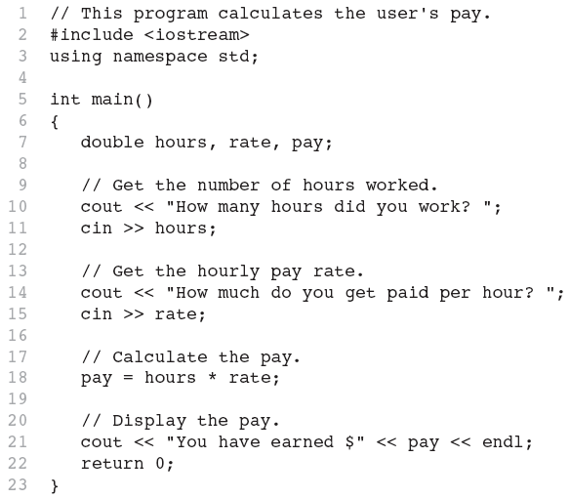
Program

Slide 10
Key Words
Also known as reserved words
Have a special meaning in C++
Can not be used for any other purpose
Key words in the Program: using, namespace, int, double, and return

Slide 11
Key Words

Slide 12
Programmer-Defined Identifiers
Names made up by the programmer
Not part of the C++ language
Used to represent various things: variables (memory locations), functions, etc.
In Program: hours, rate, and pay.

Slide 13
Operators
Used to perform operations on data
Many types of operators:
  Arithmetic - ex: +,-,*,/
  Assignment – ex: =
Some operators in Program:
<< >> = *

Slide 14
Operators

Slide 15
Punctuation
Characters that mark the end of a statement, or that separate items in a list
In Program: , and ;

Slide 16
Punctuation

Slide 17
Syntax
The rules of grammar that must be followed when writing a program
Controls the use of key words, operators, programmer-defined symbols, and punctuation

Slide 18
Variables
A variable is a named storage location in the computer’s memory for holding a piece of data.
In Program we used three variables:
  The hours variable was used to hold the hours worked
  The rate variable was used to hold the pay rate
  The pay variable was used to hold the gross pay

Slide 19
Variable Definitions
To create a variable in a program you must write a variable definition (also called a variable declaration)
Here is the statement from Program that defines the variables:
double hours, rate, pay;

Slide 20
Variable Definitions
There are many different types of data, which you will learn about in this course.
A variable holds a specific type of data.
The variable definition specifies the type of data a variable can hold, and the variable name.

Slide 21
Variable Definitions
Once again, line 7 from Program:
double hours, rate, pay;
The word double specifies that the variables can hold double-precision floating point numbers.

Slide 22
All problems can be sloved as
Sequences
Conditionals
Loops

Slide 23
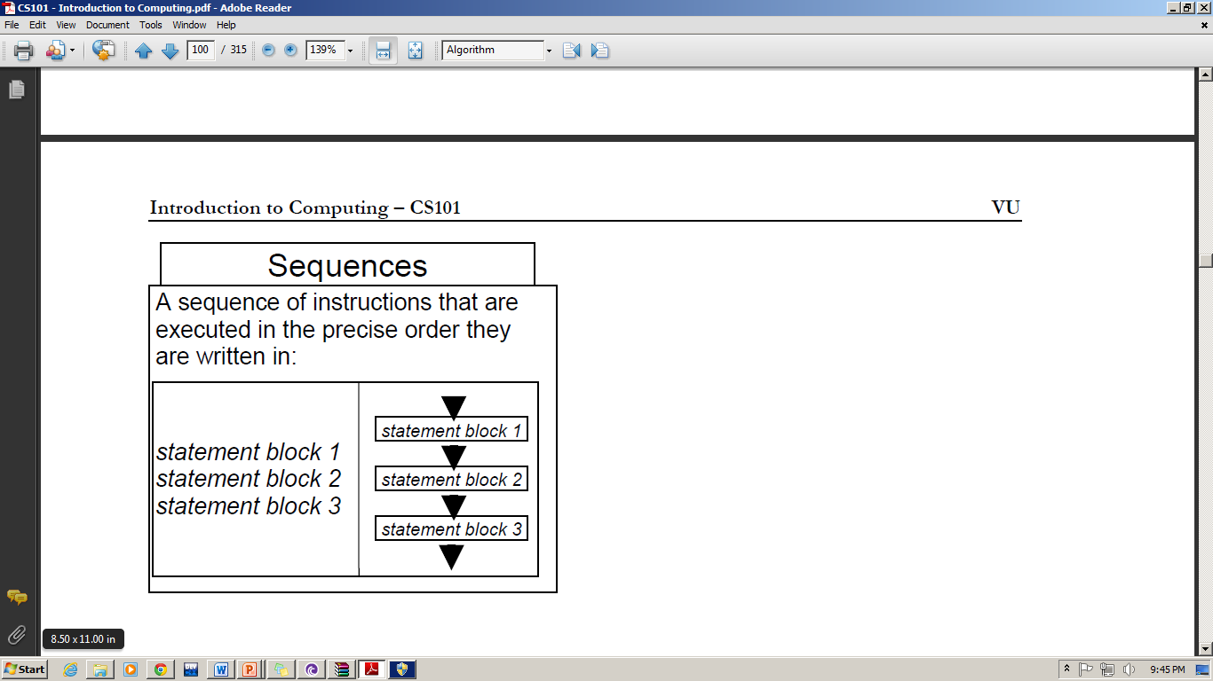
Sequences

Slide 24
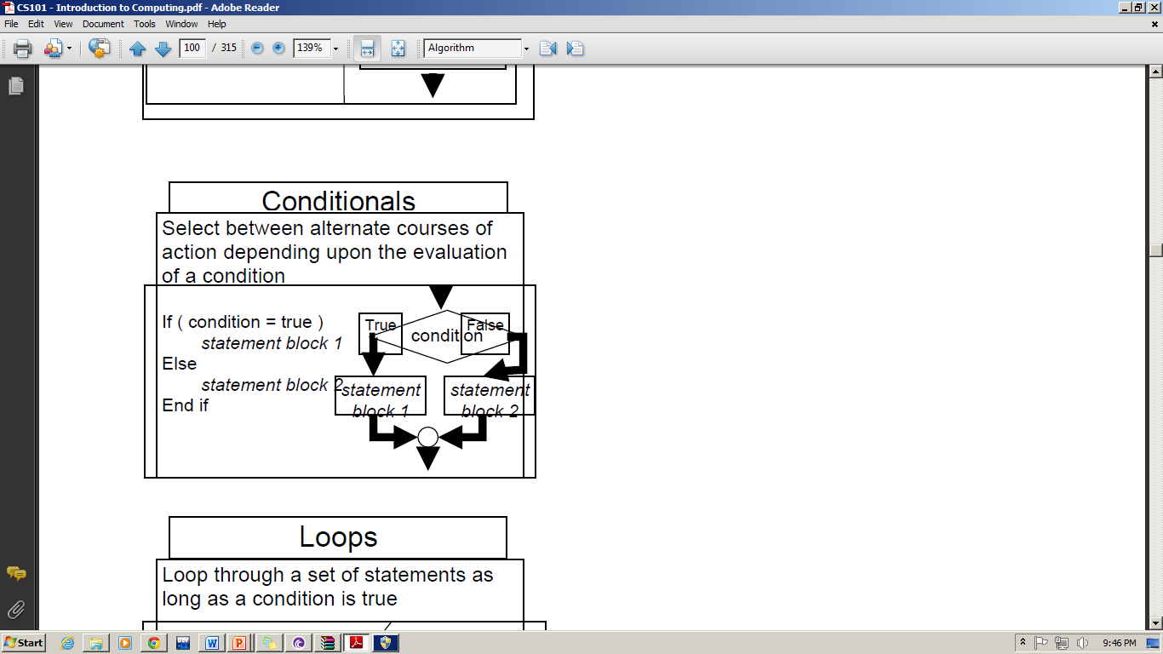
Conditions

Slide 25
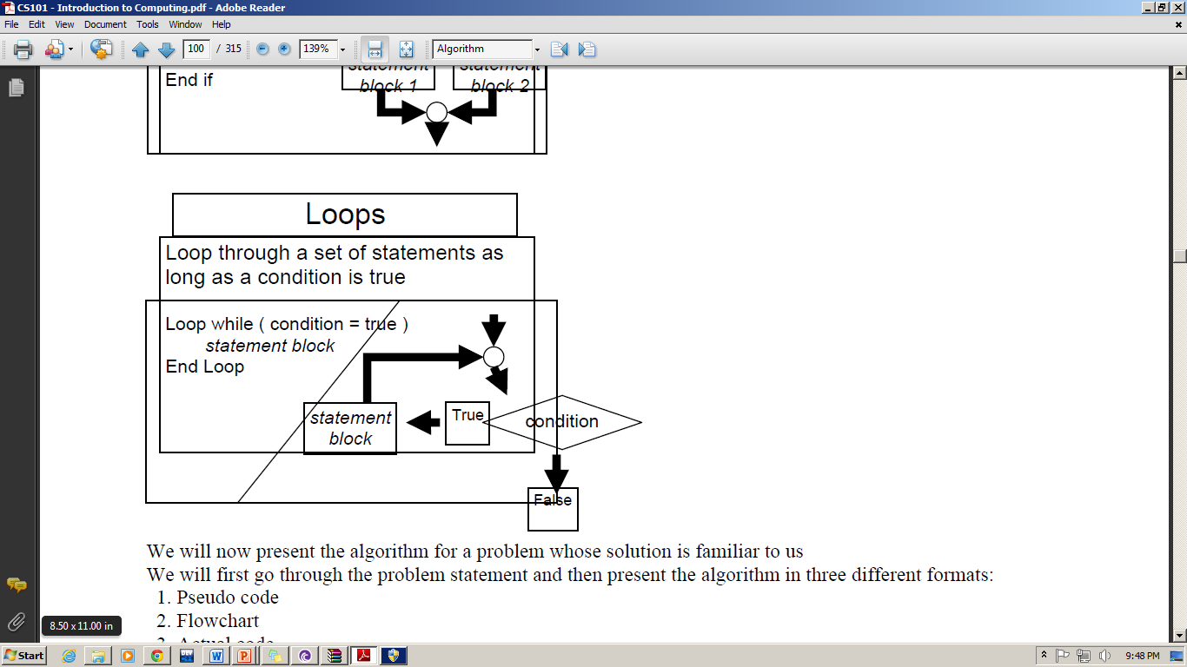
Loops

Slide 26
Program Deign Process
Requirements Analysis
Design
Coding
Testing
Deployment

Slide 27
What skills are Required for Programming?
Attention to Details
Care for Reusability
Think of user Friendliness
Understand that Computers are stupid

Slide 28
Mathematical Expressions

Slide 29
Mathematical Expressions
Can create complex expressions using multiple mathematical operators
An expression can be a literal, a variable, or a mathematical combination of constants and variables
Can be used in assignment, cout, other statements:
  circum = 2 * PI * radius;
  cout << "border is: " << 2*(l+w);

Slide 30
Order of Operations
In an expression with more than one operator, evaluate in this order:
  - (unary negation), in order, left to right
  * / %, in order, left to right
  + -, in order, left to right
In the expression 2 + 2 * 2 – 2
evaluate
first
evaluate
third
evaluate
second

Slide 31
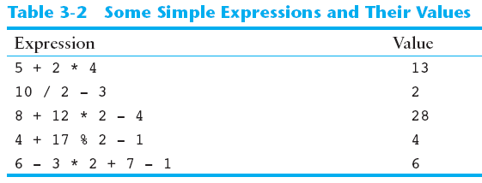
Order of Operations

Slide 32
Associativity of Operators
- (unary negation) associates right to left
*, /, %, +, - associate right to left
parentheses ( ) can be used to override the order of operations:
  2 + 2 * 2 – 2 = 4
  (2 + 2) * 2 – 2 = 6
  2 + 2 * (2 – 2) = 2
  (2 + 2) * (2 – 2) = 0

Slide 33
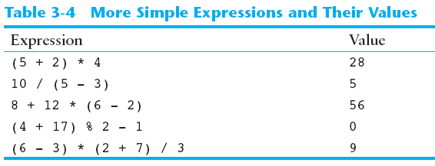
Grouping with Parentheses

Slide 34
Algebraic Expressions
Multiplication requires an operator:
  Area=lw is written as Area = l * w;
There is no exponentiation operator:
  Area=s² is written as Area = pow(s, 2);
Parentheses may be needed to maintain order of operations:
  is written as
  m = (y2-y1) /(x2-x1);

Slide 35
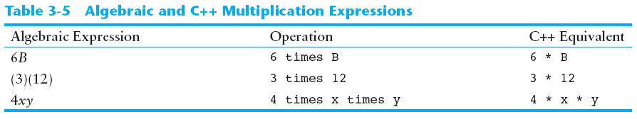
Algebraic Expressions

Slide 36
When You Mix Apples with Oranges: Type Conversion

Slide 37
When You Mix Apples with Oranges: Type Conversion
Operations are performed between operands of the same type.
If not of the same type, C++ will convert one to be the type of the other
This can impact the results of calculations.

Slide 38
Hierarchy of Types
Highest:
Lowest:
Ranked by largest number they can hold
long double
double
float
unsigned long
long
unsigned int
int

Slide 39
Type Coercion
Type Coercion: automatic conversion of an operand to another data type
Promotion: convert to a higher type
Demotion: convert to a lower type

Slide 40
Coercion Rules
1) char, short, unsigned short automatically promoted to int
2) When operating on values of different data types, the lower one is promoted to the type of the higher one.
3) When using the = operator, the type of expression on right will be converted to type of variable on left

Slide 41
Overflow and Underflow

Slide 42
Overflow and Underflow
Occurs when assigning a value that is too large (overflow) or too small (underflow) to be held in a variable
Variable contains value that is ‘wrapped around’ set of possible values
Different systems may display a warning/error message, stop the program, or continue execution using the incorrect value

Slide 43
Type Casting

Slide 44
Type Casting
Used for manual data type conversion
Useful for floating point division using ints: double m;
m = static_cast<double>(y2-y1)
/(x2-x1);
Useful to see int value of a char variable:
char ch = 'C';
cout << ch << " is "
<< static_cast<int>(ch);

Slide 45
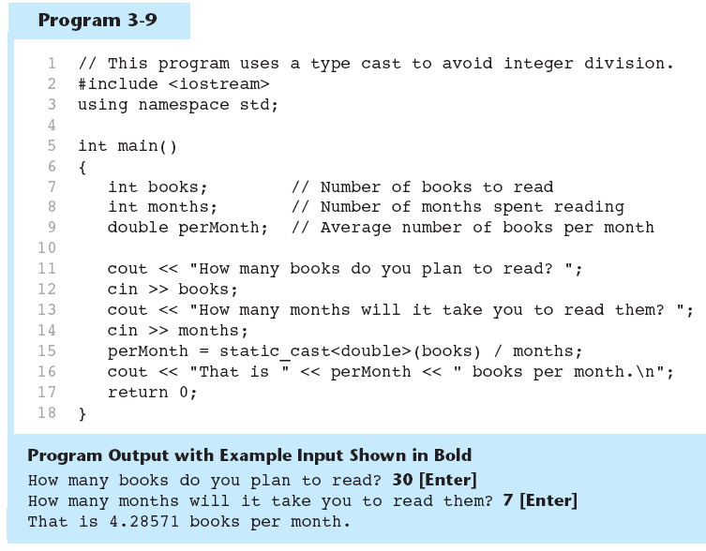
Type Casting in Program

Slide 46
C-Style and Prestandard Type Cast Expressions
C-Style cast: data type name in ()
cout << ch << " is " << (int)ch;
Prestandard C++ cast: value in ()
cout << ch << " is " << int(ch);
Both are still supported in C++, although static_cast is preferred

Slide 47
Multiple Assignment and Combined Assignment

Slide 48
Multiple Assignment and Combined Assignment
The = can be used to assign a value to multiple variables:
  x = y = z = 5;
Value of = is the value that is assigned
Associates right to left:
  x = (y = (z = 5));
value
is 5
value
is 5
value
is 5

Slide 49
Combined Assignment
Look at the following statement:
  sum = sum + 1;
  This adds 1 to the variable sum.

Slide 50
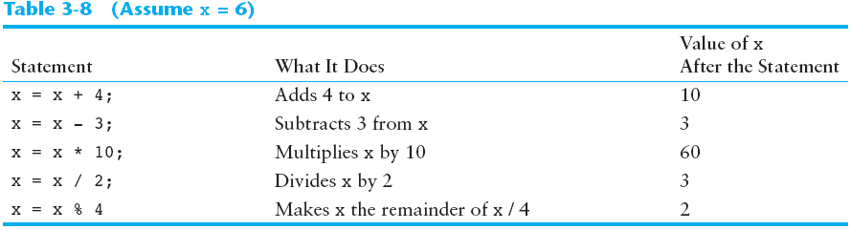
Other Similar Statements

Slide 51
Combined Assignment
The combined assignment operators provide a shorthand for these types of statements.
The statement
  sum = sum + 1;
  is equivalent to
  sum += 1;

Slide 52
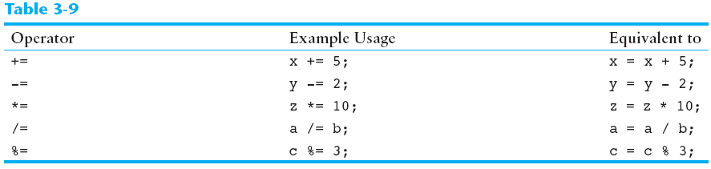
Combined Assignment Operators

Slide 53
Relational Operators

Slide 54
Relational Operators
Used to compare numbers to determine relative order
Operators:
> | Greater than
< | Less than
>= | Greater than or equal to
<= | Less than or equal to
== | Equal to
!= | Not equal to

Slide 55
Relational Expressions
Boolean expressions – true or false
Examples:
  12 > 5 is true
  7 <= 5 is false
  if x is 10, then
  x == 10 is true,
  x != 8 is true, and
  x == 8 is false

Slide 56
Relational Expressions
Can be assigned to a variable:
  result = x <= y;
Assigns 0 for false, 1 for true
Do not confuse = and ==

Slide 57
Lets Summarize

Slide 58
References
Computer Basics: Custom Guide 2007, © 2007 Custom Guide, Inc
C++ How to Program Dietel & Dietel 9th Edition
Tony Gaddis early chapters

